Slide 1

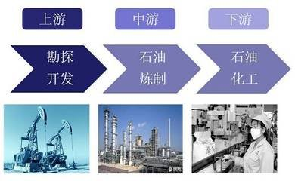

text A
The Three Subdivisions of Oil Industry
I. Text Organization
II. Language Points
III. Mind Mapping
IV. Content Information
V. Summary

Slide 2

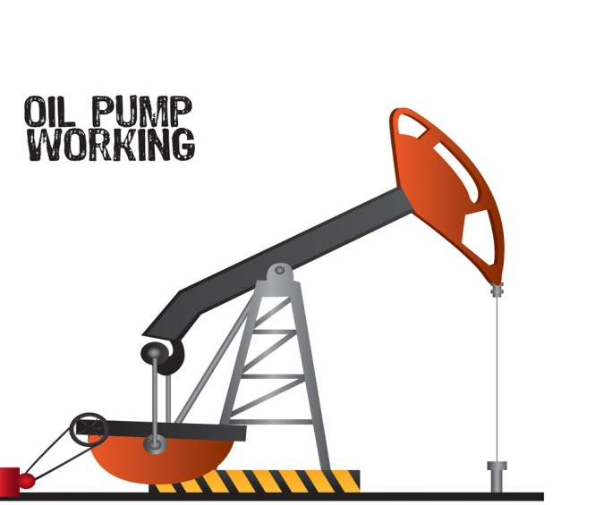
Text A
Text Organization
Part 1 (para.1) Introduction:
Three subdivisions of oil industry
Part 2 (para. 2-10) Upstream
Part 3 (Para. 11-17) Midstream
Part 4 (Para. 18-25) Downstream

Slide 3
Text A
Information Analysis
Para 1 Introduction: Three subdivisions of oil industry
Upstream, Midstream, and Downstream
Para 2-10 Upstream
Para 2-4 What is the Upstream?
Definition:
The part of the oil production process that focuses on locating and recovering crude oil and natural gas

Slide 4
Text A
Information Analysis
Function:
setting a strong, early foundation for everything that will follow.
Main components:
searching out and selecting potential oil sites, evaluation of these sites, drilling exploratory wells, and operating these wells to extract crude oil.

Slide 5
Text A
Information Analysis
Para 5 Searching for Potential Oil and Gas Fields
Importance of this step: providing the crude oil for the midstream and downstream divisions.
Experts in charge: geologists
Tools involved: Satellites Images, Gravity Meters, Magnetometers, Sniffers, Compressed-Air Guns, Thumper Trucks, Explosives,
Hydrophones, and Seismometers.

Slide 6
Text A
Information Analysis
Para 6-8 Drilling Exploratory Wells
Purposes for drilling exploratory wells:
to find out if there is oil present, if it is present in a sufficient quantity and if the quality warrants a permanent well.
Reason why this step cannot be skipped:
Without actually digging down and collecting physical
samples, even the most advanced seismic surveys yield incomplete or potentially false information.

Slide 7
Text A
Information Analysis
Para 9-10 Upstream fuels the midstream and downstream processes
Why does Upstream comprise the essential first step in the entire extraction to refining process?
Without a good strong foundation in the upstream segment of the industry, there wouldn’t be any oil or there would be insufficient amounts of oil for the rest of the industry to utilize, thus adversely affecting consumers dependent on oil-based products for a vast range of products, fuel and energy.

Slide 8
Text A
Information Analysis
Para 11-17 Midstream
Para 11-14 What is Midstream?
Definition: the sector primarily concerned with the transportation of oil and natural gas from the extraction site to the refineries.
Things to be done before transportation:
Compressing the fluids to necessary pressures
Treating materials to remove impurities such as water vapor or hydrogen sulfide.
Converting heavier hydrocarbons at the production site.

Slide 9
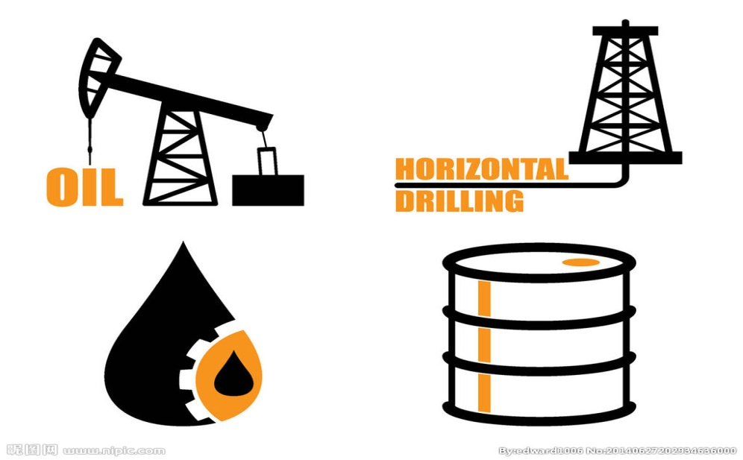
Text A
Information Analysis
Jobs involved in the midstream sector:
Chemical engineers, petroleum pump system operators, business advisors, energy and gas mangers and midstream consultants.
Things companies should be aware of:
Minimizing pollutants that may result from miles and miles of pipelines.

Slide 10
Text A
Information Analysis
Para 15-17 The Midstream of the Future
1. How will the midstream sector benefit?
It will benefit by anticipating demand and delivering customized crude blends and dynamic storage options to end-users.
2. Who will dominate this sector in the future?
Midstream majors will dominate the sector, but niche
opportunities will continue to exist for innovative and
opportunistic smaller players.

Slide 11
Text A
Information Analysis
Para 18-25 Downstream
Para 18-21 What is Downstream?
Definition: the part of the petroleum industry responsible for final processing, product distribution and marketing.
Work involved in this sector:
1.Processing crude oil into finished products like
heating oil, asphalt, lubricants, synthetic rubber, plastics,
fertilizers, pesticides, and pharmaceuticals.
2.Marketing, customer service and strategic planning for
the sale and distribution of finished products.

Slide 12
Text A
Information Analysis
Jobs in this sector:
process hazard analysts, tax accountants, plant operators, maintenance supervisors, contracts managers and instrument engineers
Para 22 Oil and Gas Refining
Describe the refining process:
The refining is done by means of distillation. The first step involves separating different hydrocarbons apart into different groups or fractions, by taking advantage of their different boiling points. The lightest of the chemicals evaporate

Slide 13
Text A
Information Analysis
first and further processed into liquid petroleum or naphtha. Hydrocarbons with middle evaporate temperatures produce jet fuel and kerosene while the heaviest elements form residual fuel oil.
Para 23-25 Products
Main products: liquefied petroleum gases, naphtha, gasoline, kerosene, diesel, fuel oil, lubricant oils, asphalt, and petroleum coke.

Slide 14

Text A
Information Analysis
Uses :
every day applications (transportation, heating, etc), petrochemical industry for manufacturing rubber, nylon, plastics and other kinds of derivatives.
Factors taken into account in operating refinery:
wide variation in price and the seasonality of consumption for the products

Slide 15

Text A
Language points
Para 1
The oil industry is a massive, multi-faceted environment that spans a number of different processes and occupations. Because it is so complex and encompasses so much, it is divided into three distinct sections based on the steps form drilling to refinement.
石油工业是一个范围广大、方面众多、涵盖一系列不同生产过程和职业的行业。因其复杂性和综合性，人们根据从钻井到炼制的不同步骤，将其分成三个不同的分支。

Slide 16
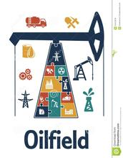
Text A
Language Points
Para 6
This stage of the process represents a significant financial risk to the oil company because exploratory drilling is expensive and there is no guarantee that there will be a return on investment.
这一阶段对石油公司来说意味着很大的经济风险,因为探井造价高昂并且不一定确保有投资回报。

Slide 17
Text A
Language Points
Para 8
Often times the exploratory drilling must be done in underwater conditions… The step of exploratory drilling cannot be skipped because without actually digging down and collecting physical samples, even the most advanced seismic surveys yield incomplete or potentially false information. 勘探钻井常常需要在水下操作。勘探钻井是必不可少的，如果没有地层钻探和实体样品收集，即使是最先进的地震勘探采集到的信息也是不完整的或可能是错误信息。
。

Slide 18

Text a
Language Points
yield vt. 生产，带来
yield n. 产量
(Para. 8 last line:)
……even the most advanced seismic surveys yield incomplete or potentially false information.
(Para. 25, L. 1:)
The crude oil is initially distilled and the initial product yields can be improved by using……
词性对比：

Slide 19
Text A
Language points
Para 9
These process categories are fairly generic terms and are simply used as …….to upstream, midstream, and downstream, making overlap common.
这些过程的分类只是泛指，用来简单区分不同的生产环节。很多石油公司都对上游产业、中游产业、以及下游产业实行垂直一体化经营，这也使得重叠部分非常常见。

Slide 20
Text A
Language points
Para 12
Removing impurities and compressing the fluids helps maximize ……is an important aspect in this sector of the industry.
通过去除杂质和压缩液态石油，能够最大限度地运
输石油和天然气，从而使石油公司实现效率和收益
的最大化，这也是中游产业一个重要的方面。

Slide 21
Text A
Language points
Para 16
Using better forecasting analytics, the sector will
benefit by anticipating demand and delivering customized crude blends and dynamic storage options to end-users.
通过更好地预测分析，这些产业可以通过预测需求、运输定制的原油混合物、以及为终端客户提供动态的储存方案来获益。

Slide 22
Text A
Language points
Para 17
Within the midstream sector, midstream majors are strongly placed ……and what is the most important, growing dominance in new and emerging shale plays.
在中游产业中，相比起中小型企业，大型公司更能带动这一领域的发展。这源于其雄厚的资金实力、在整个价值链中的位置，以及最为重要的是，在新发现的页岩气的开采中日益起主导地位。
（Notes: shale plays, favorable exploration area for shale oil and gas, 页岩油气藏。）

Slide 23
Text A
Language points
Para 18
It is also where …..where customers meet companies.
下游产业也是满足消费者需求，企业与消费者直接交流的环节。

Slide 24
Text A
Language points
Para 22
It follows that because crude oil is made up of……into separate groups or fractions.
it follows that… 由此可见…,由此断定…
由于原油是由几种不同的碳氢化合物组成的，因此，提炼过程的第一步就是把这些不同的分子分离成单独的群组或馏分。

Slide 25
Text A
Language points
Para 25
The crude oil is initially distilled and the initial product yields can be improved …… The classical way of operating the refinery takes into account the wide variation in price and the seasonality of consumption for the products.
首先对原油进行蒸馏,可以通过使用其它炼制设备(转化设备）对碳氢化合物进行化学改变（裂化、重组或改变分子）提高初始产量。炼油厂的传统运作需要把两个因素考虑在内，一是价格的巨大波动，二是产品消费的季节性因素。

Slide 26

Exercise book (31): I. Mind Mapping
Text a
Keys to the blanks:
1. upstream, midstream, and downstream.
2. locating and recovering crude oil and natural gas
3. setting foundation
4. exploration, development and processing
5. crude oil
6. ensuring quantity and quality
7. the transportation of oil and natural gas
from the extraction site to the refineries

Slide 27
I. Mind Mapping
Text a
Keys to the blanks:
8. compressing; removing impurities and converting
9. final processing, product distribution and marketing
10. processing and marketing
11. distillation

Slide 28
II. Content Information
Text a
1. Because it is very complex and encompasses so much.
2. The upstream is mainly concerned with the oil production process that focuses on locating and recovering crude oil and natural gas.
3. It is primarily concerned with the transportation of oil and natural gas from the extraction site to the refineries, and often included as an extension of either the upstream or downstream sector, depending on the source.

Slide 29
II. Content Information
Text a
4. Midstream majors are strongly placed to ride the growth cycle better than small and medium-sized companies due to their financing prowess, presence across the value chain and what is the most important, growing dominance in the new and emerging shale plays.
5. The downstream sector processes crude oil into finished products. It is where supply meets demand and where customers meet companies. Jobs in this sector include process hazard analysts, tax accountants, plant operators, maintenance supervisors, contracts managers and instrument engineers.
6. Wide variation in price and seasonality of consumption for the products.

Slide 30
III. Summary
Text A
Sample: The oil industry is divided into three distinct sections based on the steps from drilling to refinement: upstream, midstream and downstream.
Upstream is the part of the oil production process that focuses on locating and recovering crude oil and natural gas. It occurs first and sets a strong, early foundation for everything that will follow.
Midstream is the sector primarily concerned with the transportation of oil and natural gas from the extraction site to the refineries. Oil and gas transportation is a highly technical process involving compressing the fluids to necessary pressures, treating materials to remove impurities such as water vapor or hydrogen sulfide and converting heavier hydrocarbons at the production site.
Downstream is the part of the petroleum industry responsible for final processing, product distribution and marketing. It is where supply meets demand and where customers meet companies.

